Slide 1


DATA
ANALYTICS
By : Raviteja
SLRK

Slide 2


Today's agenda
Project recap
Problem
The Analytics team
Process
Insights
Summary

Slide 3

Socsial Buzz is the fastest growing social media technology an it’s a unicorn which need support to scale up to global level and it is taking consultancy from the Accenture from 3 moths POC focusing on these tasks.
Auditing Social Buzz’s big data practice.
Recommendations for a successful IPO.
Analysis to find Social Buzz’s top 5 most popular categories of content.
Project Recap

Slide 4

Problem
Over 100000 posts per day.
36,500,000 pieces of content per year!
But how to capitalize on it when there is os much!
Anslysis to find social buzz’s top most popular categories of ocntent

Slide 5



Maria Hans
CTA
The Analytics team
Raviteja Kulkarni
SeniorData Analyst
Marcos May Business Analyst

Slide 6
Data Understanding
Process
1
Data Cleaning
2
Data Modelling
3
4
Data Analysis
5
Uncover Insights

Slide 7

Insights
16
1897
JANUARY
UNIQUE CATEGORIS
REACTIONS TO “ANIMAL” POSTS
MONTH WITH MOST POSTS

Slide 8
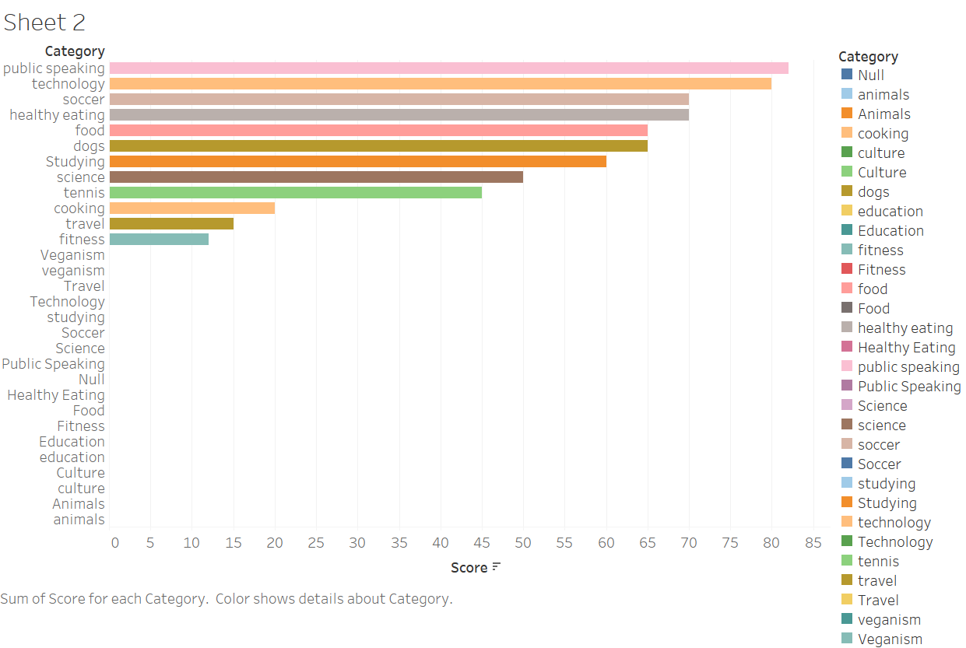
DATA VISULAZITION USING TABLEAU

Slide 9
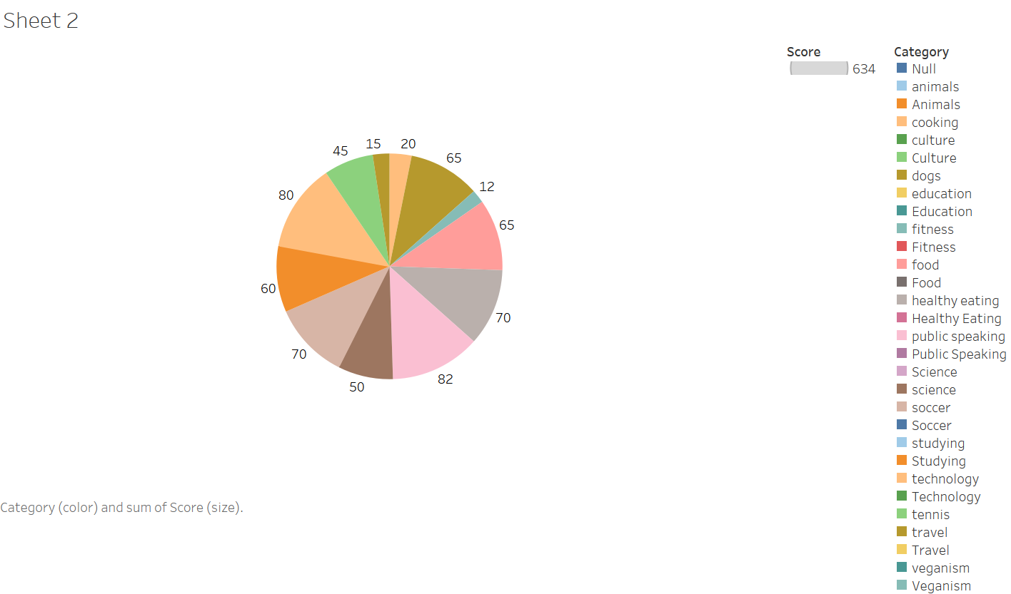
DATA VISULAZITION USING TABLEAU

Slide 10

Analysis
Public speaking and tech are the wo most popular categories of content, showing that people are interested.
Summary
Insight
Public speaking and tech are popular as your audience seem more interested in self improvement and tech so it will be better to work on campaigns based on these category.
Next Step
The ad camp analysis is insihts it takes time to understand the realtime result of the process . We can support for analysis.

Slide 11
Thank you!
ANY QUESTIONS?

